Slide 1
Journey Scrapbook
Akshat Gupta
Batch-3

Slide 2
Custom Training Week - 5
25-Sept-2023 to 29-Sept-2023

Slide 3
Day 1
PySpark –
Caching – lazy evaluation
Persist and different storage levels
Aggregation
Managed and External Tables
For-Each
Partitioning

Slide 4
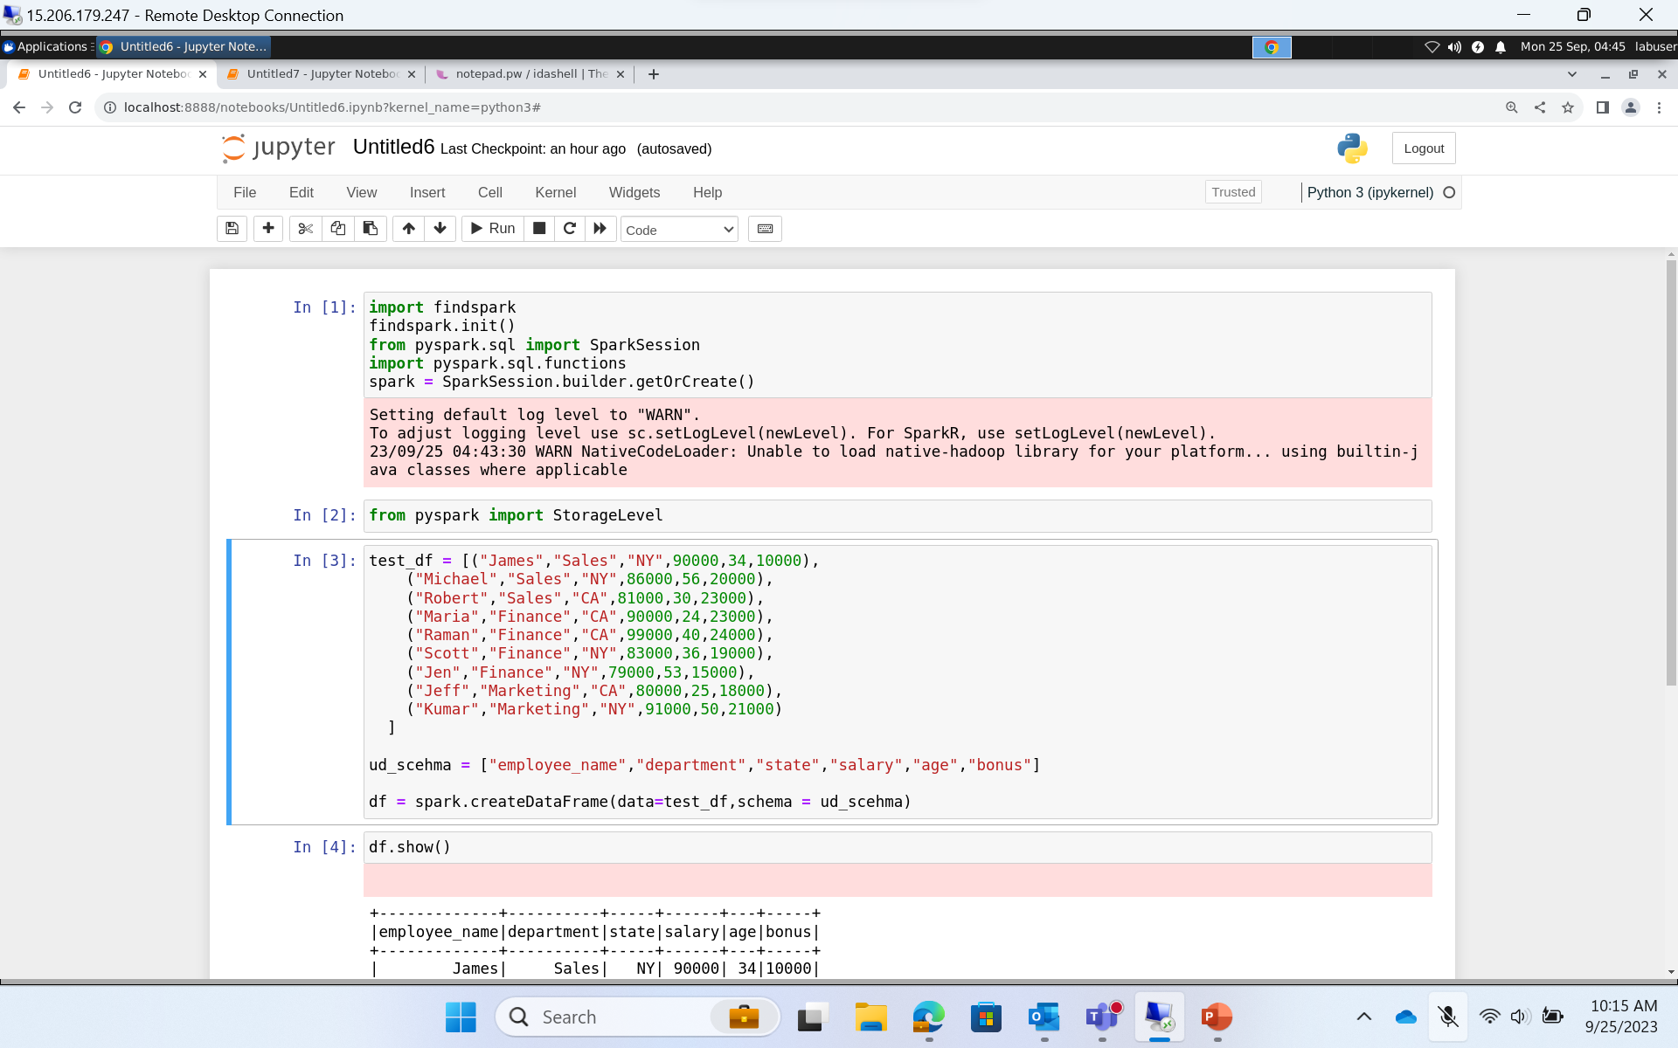

Slide 5
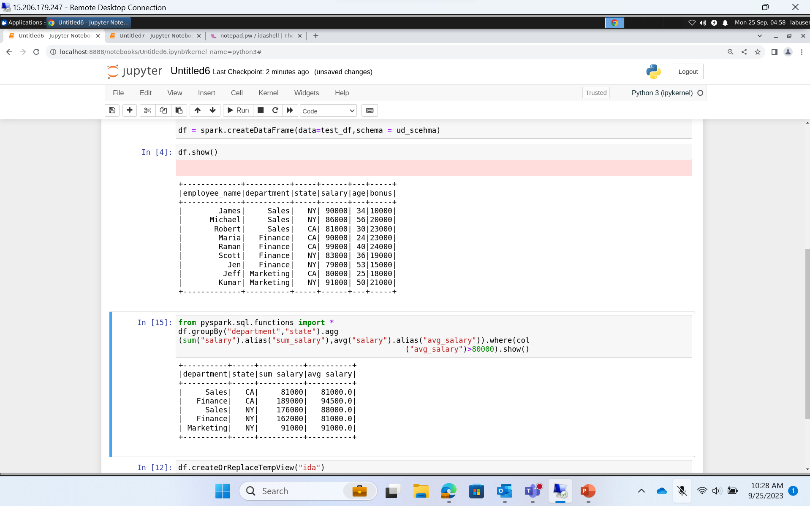

Slide 6
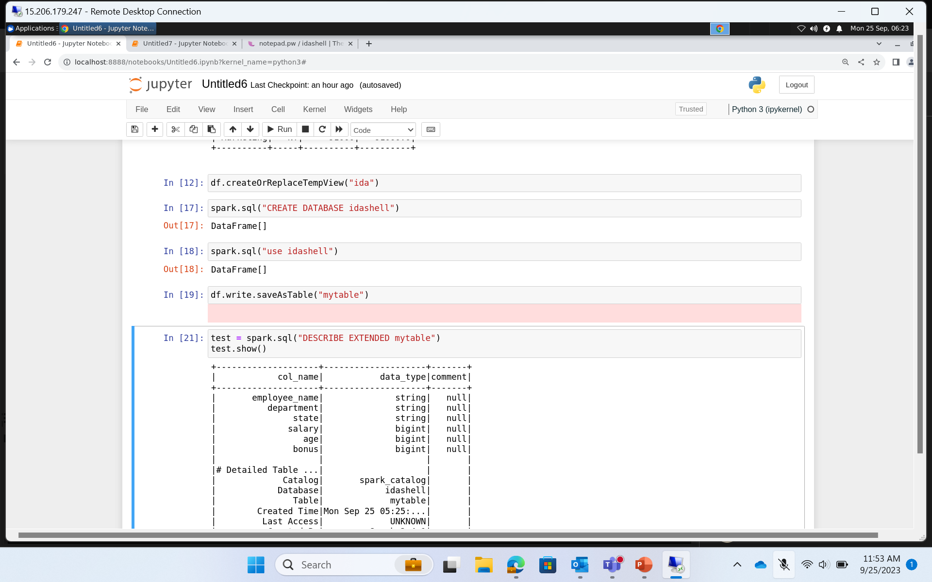

Slide 7
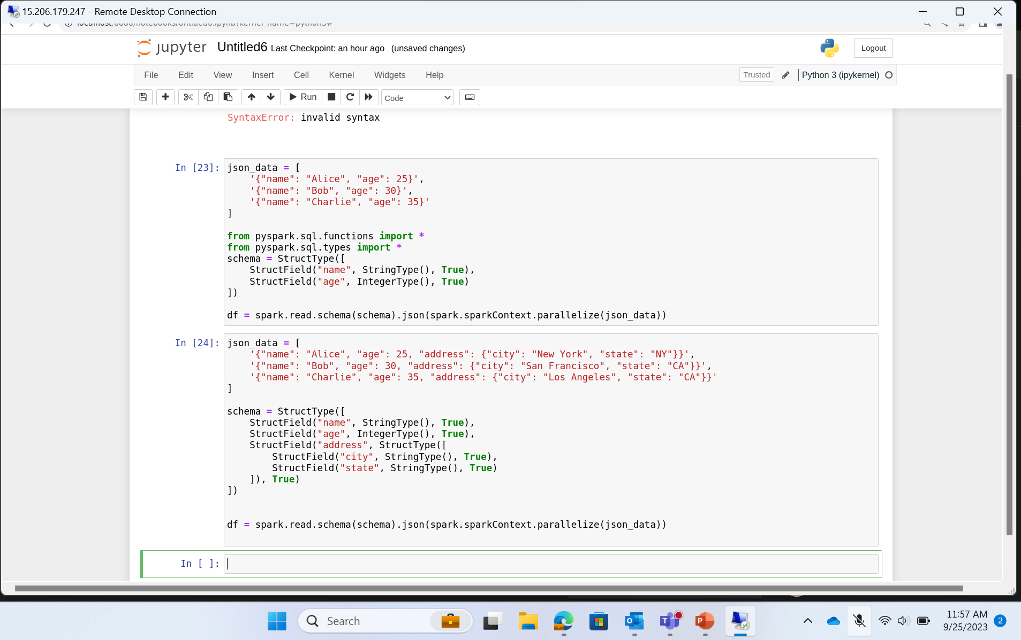

Slide 8
Day 2
Databricks –
Overview
Cluster configuration
Mounting
Widgets/Parameters
Functions
Structured Streaming
%run, %md, % lang

Slide 9
Day 3
Databricks contd.
Structured Streaming
DBFS and sample data
Delta table & Parquet table
Partition tables
Medallion/Multi hop Architecture
JDBC Connection
Unity catalogue
Metastore

Slide 10
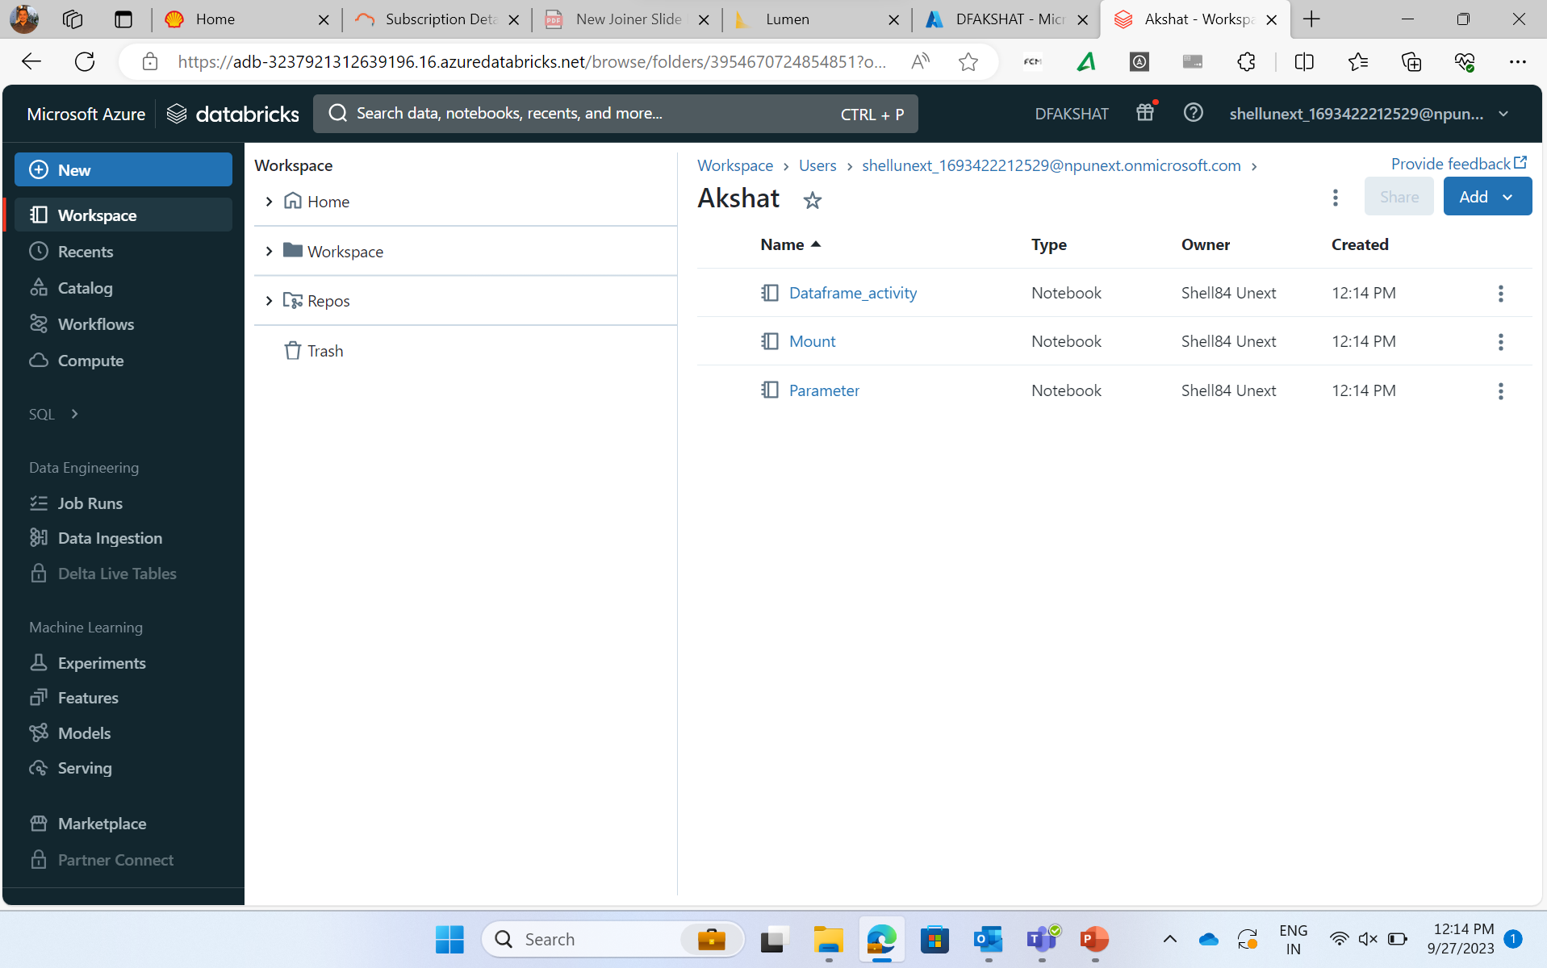

Slide 11
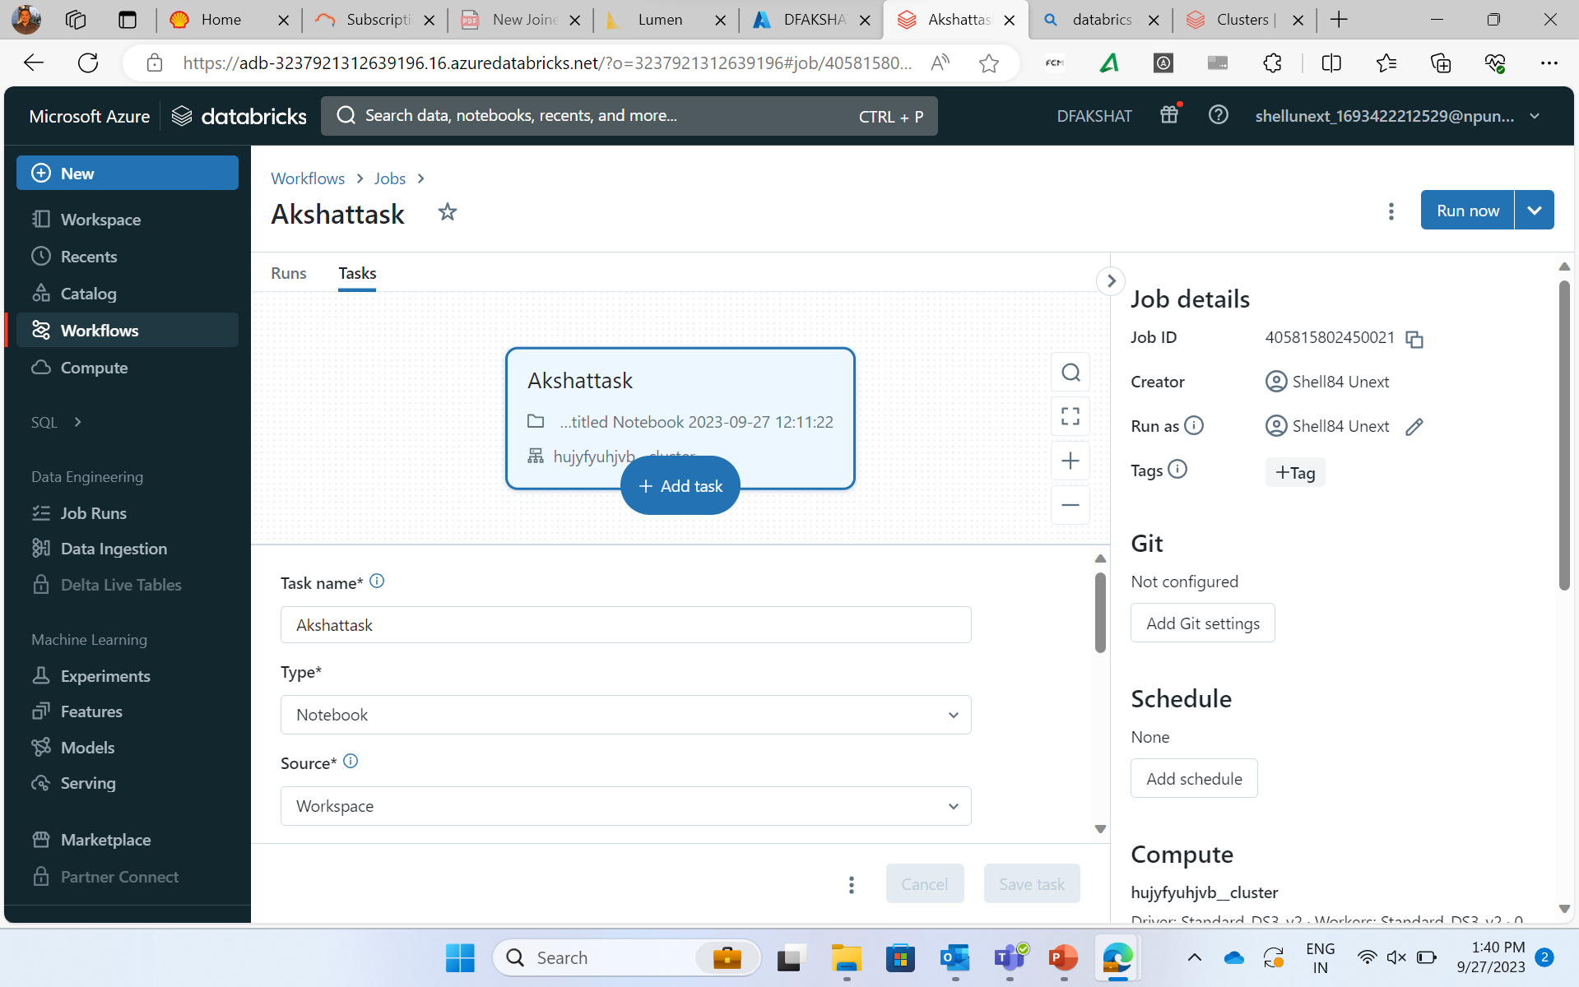

Slide 12
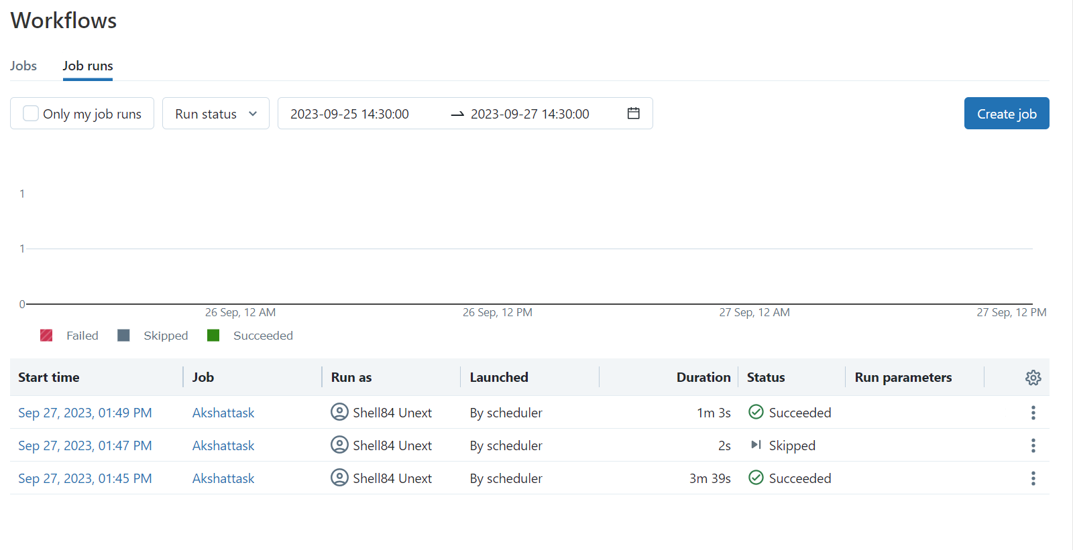

Slide 13
Day 4
What is Docker?
Docker initialization in VM
Build Docker image – Application, Requirement.txt, Dockerfile
Image created and Docker push
Azure Container Registry (ACR)
Kubernetes
AKS
Deploy a single-image application using code and UI

Slide 14
Day 5
What is DevOps?
Azure DevOps – Boards, Repos, Pipelines, Test Plans
Creating a project Board in Azure DevOps
Work items – epic, feature, user story, tasks
Azure Repos
Azure Pipelines

Slide 15
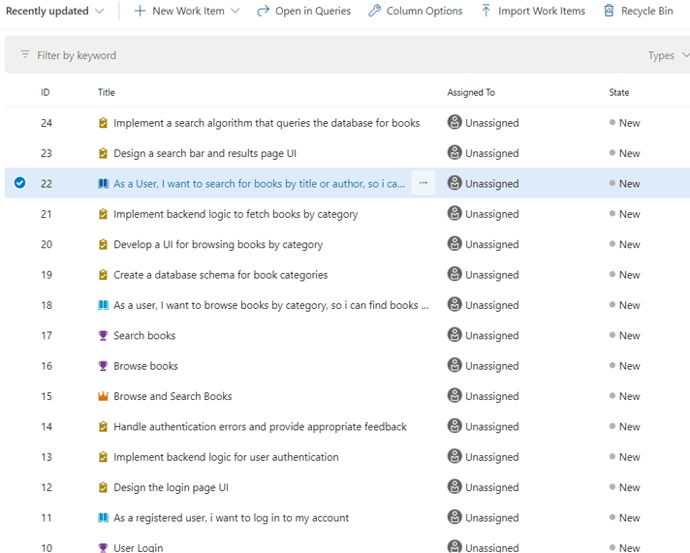

Slide 16
Thank you
Akshat Gupta
Akshat.gupta2@shell.com

